Slide 1


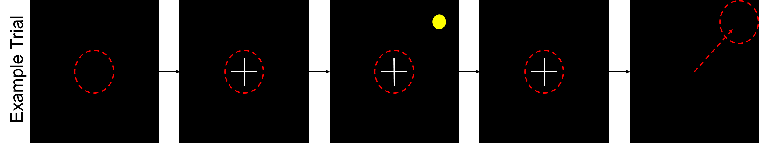
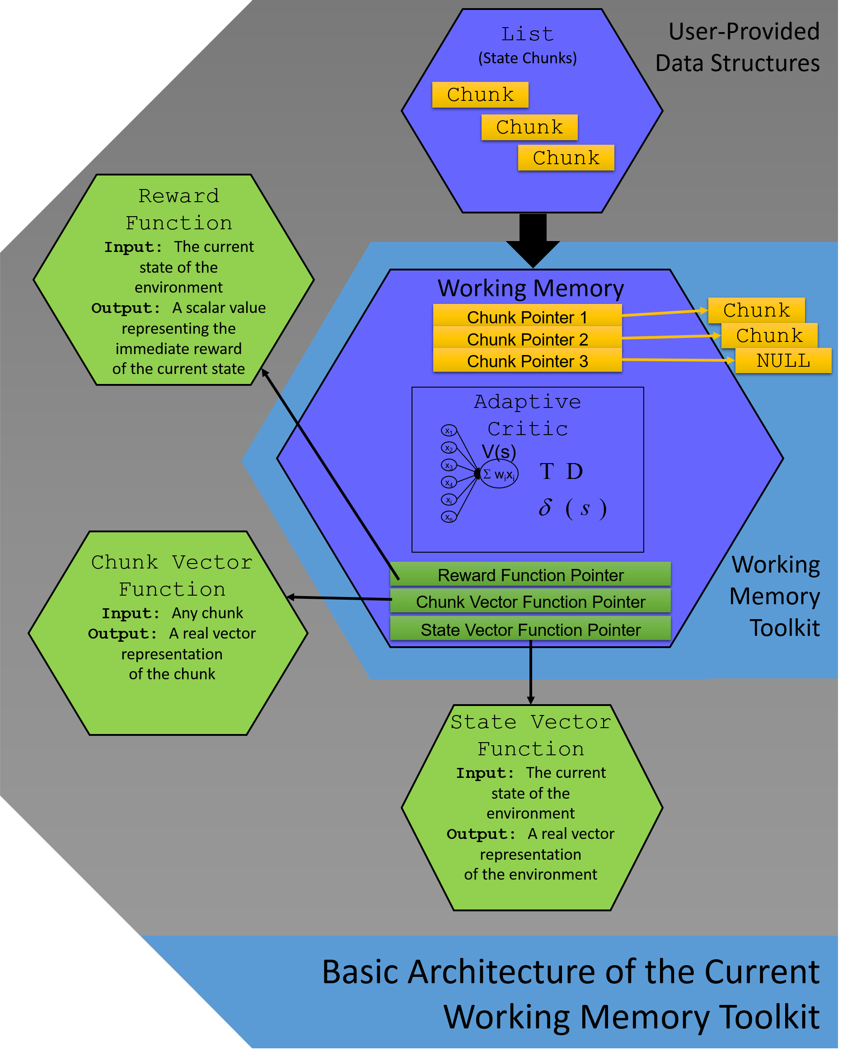
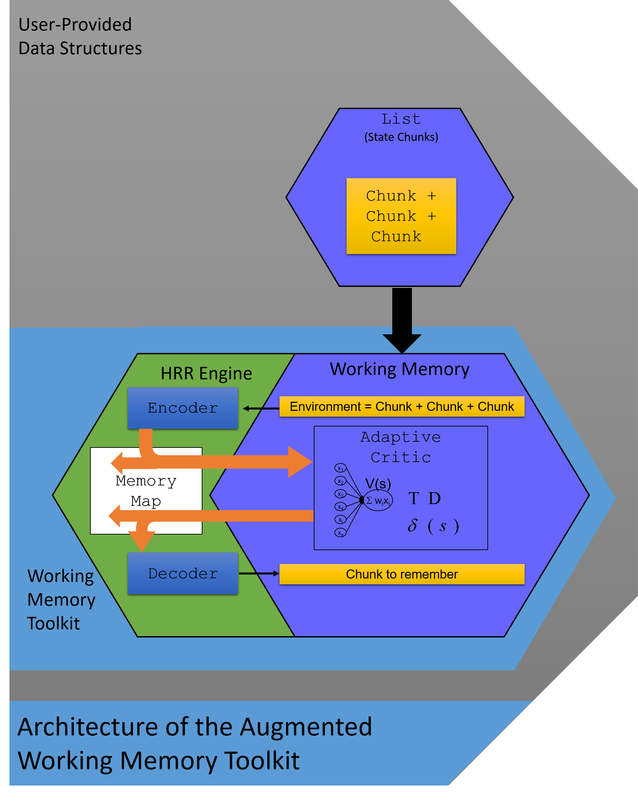
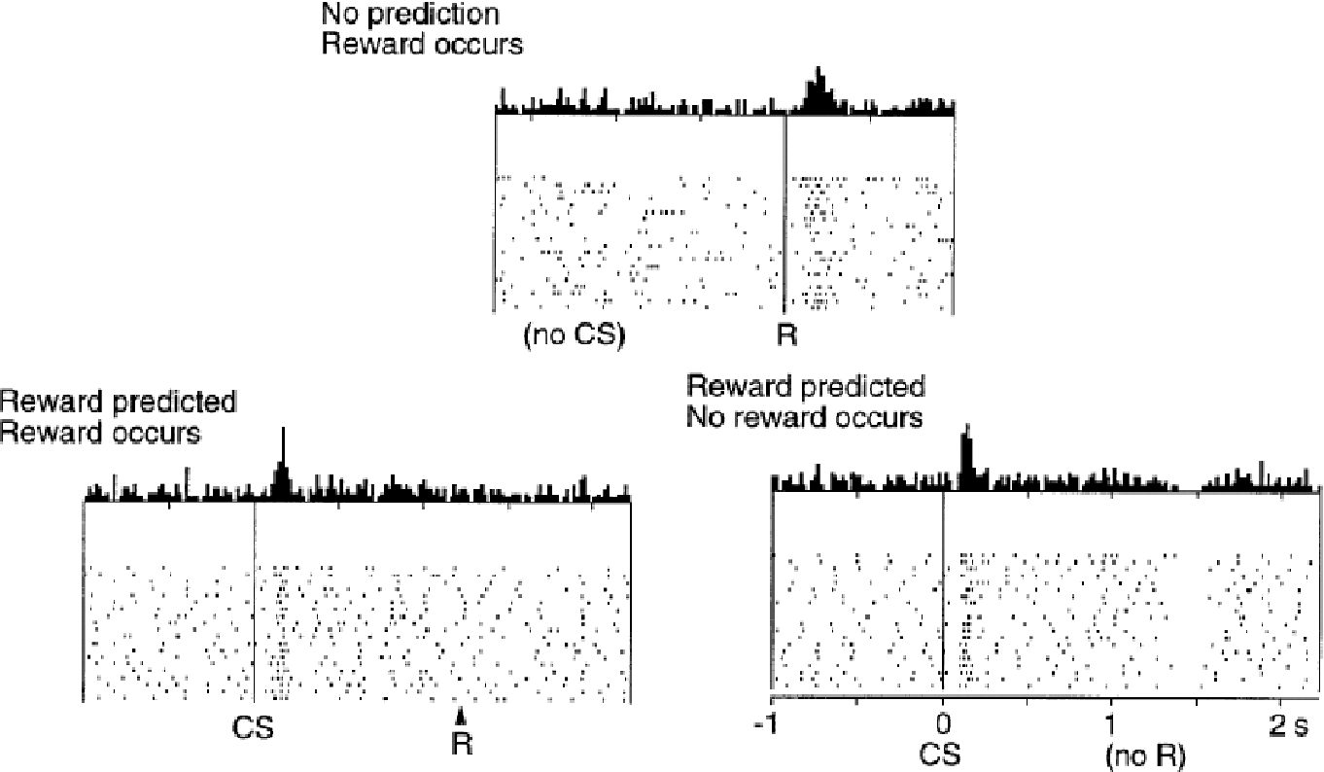
Holographic Reduced Representations for Working Memory Concept Encoding
Grayson M. Dubois and Dr. Joshua Phillips
Abstract
Artificial neural networks (ANNs) utilize the biological principles of neural computation to solve many engineering problems, but ANNs also serve as formal, testable hypotheses of brain function and learning in the cognitive sciences. However, since ANN models often employ distributed encoding (DE) of conceptual information, most have limited application in other areas of artificial intelligence where symbolic encoding (SE) is the norm (eg. robotics, games, theorem proving). A working memory toolkit (WMtk) was developed to aid the integration of an ANN-based cognitive neuroscience model of working memory into robotic systems by mitigating the details of ANN design and providing a simple DE interface. The WMtk can solve common tests of working memory performance, but DE/SE conversion needs to be programmed directly by the user and tuned specifically to each learning task. We propose that a technique called holographic reduced representation (HRR) can be used to overcome this limitation since HRRs provide a framework for manipulating concepts using a hybrid DE/SE formalism that is compatible with ANNs. We describe our current progress towards the development, integration, and testing of an HRR engine for the WMtk which automates the process of DE/SE conversion for the user and seamlessly provides additional cognitive capabilities to the WMtk such as cross-task generalization and concept chunking.
The Working Memory Toolkit
Holographic Reduced Representations
What is it?
The Working Memory Toolkit is an Open Source software library written in ANSI C++ that allows researchers to write cognitive simulations using Temporal Difference learning techniques and artificial neural networking techniques based on human working memory (Phillips, Noelle).
How Does it Work?
On each time tick, a list of candidate chunks that describe the current state of the agent – the environment – is sent to the WorkingMemory object. This is like sensory information being sent to your brain.
The WorkingMemory object tests all possible subsets of these candidate chunks that can fit within the limited capacity of worming memory. This is your brain checking to see what is worth remembering.
The combination that seems the most favorable for achieving the greatest projected reward is the set of chunks that is retained. This is when your brain has decided what is worth remembering, and sticks them in your working memory.
The temporal difference error is calculated to determine the actual reward for the current state. The reward function determines the inherent “goodness” (Phillips, Noelle) of the state, thus driving learning. This step is when you discover whether or not the items you are remembering are good or bad, which influences how much you will rely on them in the future.
The Delayed Saccade Task
One example of a task that can be simulated with the WMtk is the Delayed Saccade Task. This task is explained as follows:
The agent must focus on the center of the screen.
A crosshair pops into the center of the screen.
A dot flashes in one of the corners of the screen.
The crosshair then disappears.
The agent can then shift its focus – or “saccade to” – the area where the dot flashed.
Only when the agent performed this task in the correct sequence, was it rewarded.
Working Memory
Working memory is that part of memory which stores a few chunks of temporary information for a short period of time, and discards it after use.
The Problem:
The issue with the current working memory toolkit is that
We use working memory frequently when trying to remember small bits, or chunks, of information for a short period of time. Similar to remembering a phone number just long enough to dial it.
Since the information we
process is always handled
through working memory,
it is vital to the learning process. Concepts are learned as the mesolimbic dopamine system triggers a chemical reward in the presence of favorable circumstances.
800
123
4567
Chunk 1
Chunk 2
Chunk 3
Current Programmer Responsibilities:
Pre-potent Response
Overridden Response
Chunk Vector Function
State Vector Function
Reward Function
Pass state chunks into WMtk
Programmer Responsibilities with HRR Engine:
Pre-potent Response
Overridden Response
Pass state chunks into WMtk
References:
Phillips, Joshua L., and Noelle, David C. “What Can Robots Tell Us About Prefrontal Cortex? Explorations with the Working Memory Toolkit.” MEETING. SPONSORING ORGANIZATION. PRESENTING LOCATION. DAY, MONTH, YEAR OF POSTER. Poster presentation.
Dopamine Response to Conditioned Stimulus (CS) and Reward (R) (Shultz et al., 1997)

